Slide 1
Project for C Programming Language

Slide 2
Our team
Suyog Tiwari
Rohan Shahi

Slide 3
Table of contents
01
02
03
04
Project Introduction
Why this project?
Challenges while developing this project and features of our project
Code Review

Slide 4


01
Project Introduction

Slide 5
Introduction
Welcome ladies and gentleman to “Who wants to be a Millionaire?”. If you want to make money with your general knowledge then please do join.

Slide 6
Why we Chose this project?
Inspired by Slumdog Millionaire
How this game show can be translated into a programming terms
Joy of getting achievements and digital game show cash.

Slide 7
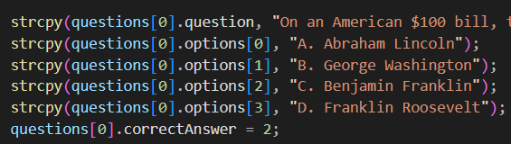
Challenges while developing this project
Challenges #1
Question clearing
after answering it
Challenges #2
Indexing format

Slide 8
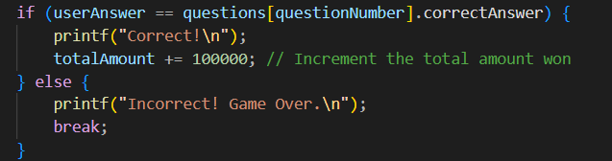
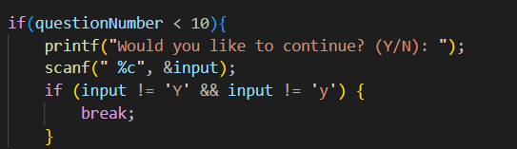
Features of our project

Slide 9
Common programming language
Html
Javascript
Java
Mercury is a really small planet
Venus is the second planet from the Sun
Despite being red, Mars is a cold place
Python
SQL
CSS
Saturn is a gas giant and has several rings
Jupiter is the biggest planet of them all
Neptune is the farthest from the Sun

Slide 10

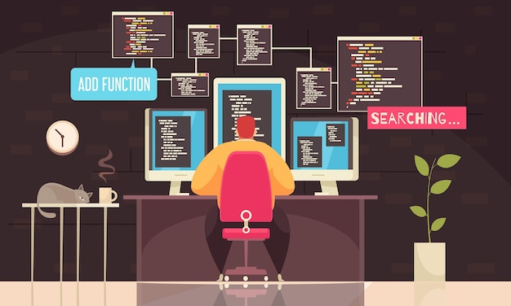

Slide 11
04
Code Review

Slide 12
Thanks!
Do you have any questions?

